Slide 1

KAĞAN ÖZASLAN CFO

Slide 2
Video Transmission
Command Transmission

Slide 3
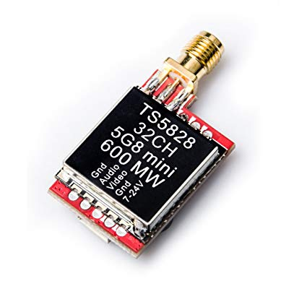
Video Transmission
5.8 Ghz
600mw Transmitter (ts5828s)
27.5 dBm

Slide 4
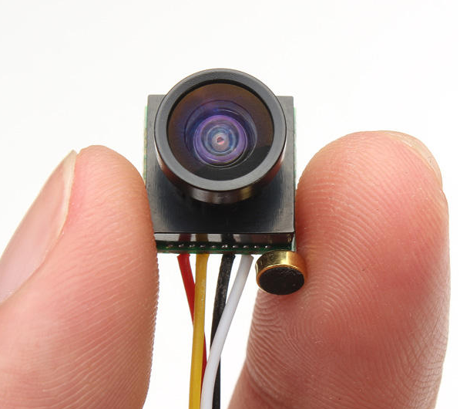
Video Transmission
5.8 Ghz
600mw Transmitter (ts5828s)
27.5 dBm
170 degree camera

Slide 5
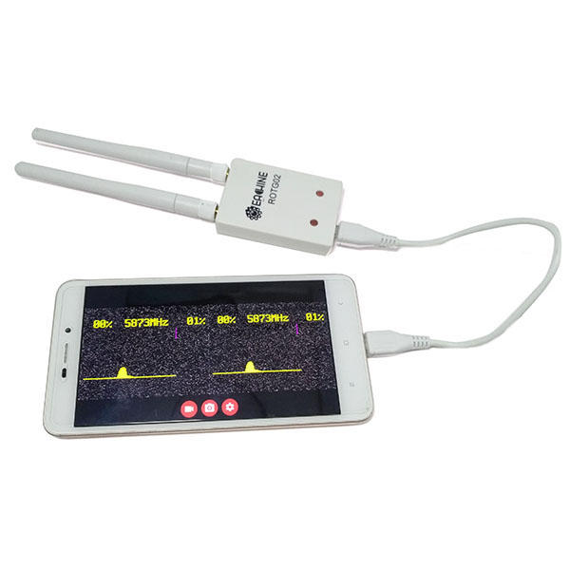
Video Transmission
5.8Ghz receiver (ROTG02)
Easy to use
Plug and Play with usb cable
Auto seek

Slide 6
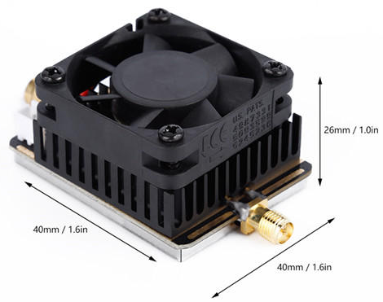
Test Results
Outdoor = 500 m
Indoor = 50 m (from E Building Top Floor to D Building Study Hall)
Improvement Option
5.8G Amplifier
27dBm to 34 dBm

Slide 7
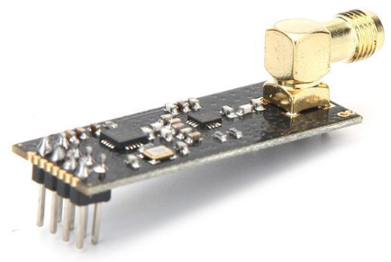
Command Transmission
2.4Ghz band
NRF24L01+ module
Very cheap (less than $2)
Compatible with high gain antennas
2.4ghz antennas are also very cheap.
Secure communication protocol.

Slide 8
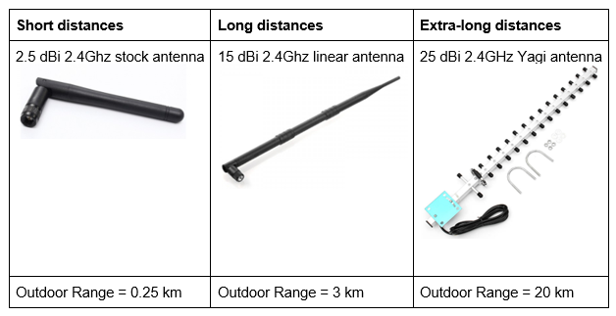
Command Transmission

Slide 9
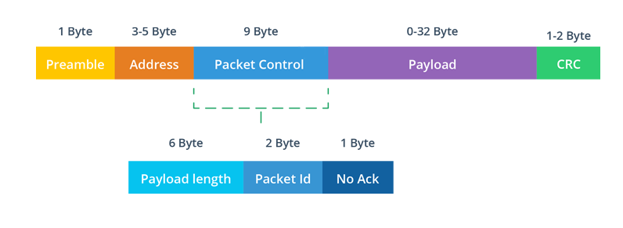
Communication Protocol

Slide 10
Preamble: Shows beginning of a packet.

Slide 11
Preamble: Shows beginning of a packet
Address: Shows the network pipe address.

Slide 12
Preamble: Shows beginning of a packet
Address: Shows the network pipe address.
Packet Control: Section for related settings.

Slide 13
Preamble: Shows beginning of a packet
Address: Shows the network pipe address.
Packet Control: Section for related settings.
Payload: Sending data is stored inside. Upon 32 byte.

Slide 14
Preamble: Shows beginning of a packet.
Address: Shows the network pipe address.
Packet Control: Section for related settings.
Payload: Sending data is stored inside. Upon 32 byte.
CRC: Cyclic redundancy check for error detection.

Slide 15
Command Transmission

